Slide 1



"Al-Driven Prediction Model for Car Pricing and Classification Based on Features and Market
Name: Hisham Ahmed Refaat
ID:221035
Name :Mostafa Hesham
ID:220367
Supervisor: Dr Mohamed Labib

Slide 2
Table
agenda
introduction
motivation
problem statement
background
objective
Literature Review
related work
Optional Slides
Proposed Solution
System architecture
Conclusion
References

Slide 3
Introduction
The automotive industry is evolving, and with the growing number of vehicles on the market, accurately assessing car values
This project aims to provide a more efficient and data-driven solution by leveraging web scraping, machine learning, and image recognition technologies to predict the price of cars based on detailed information or even by analyzing an image of the vehicle.

Slide 4
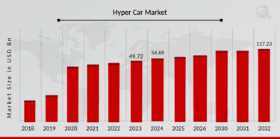
Motivation
In Egypt last 2 year his been change a lot increase in the price
Digital Transformation in Automotive Sales

Slide 5
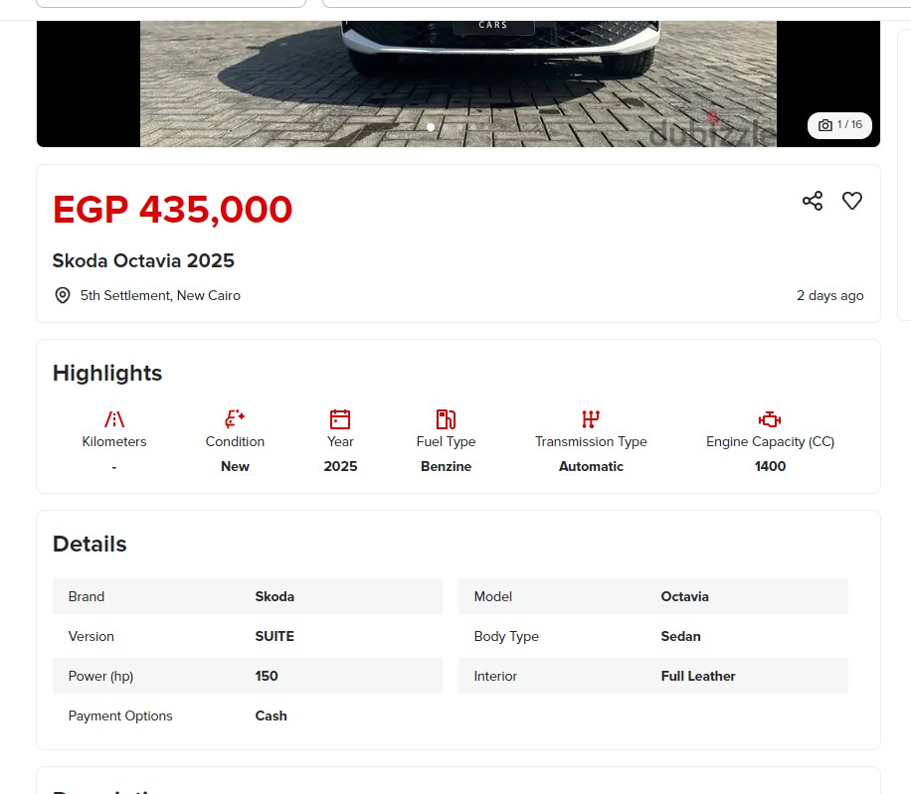
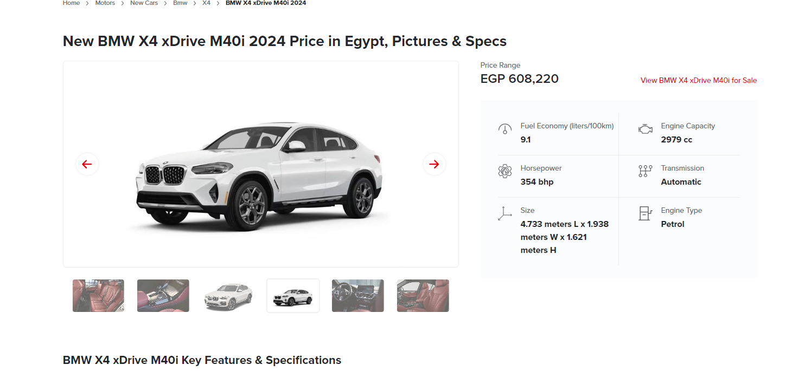
Problem Statement
The average car prices in Egypt are often inaccurate
The problem of incomplete car information
There are so many car models out there that people often get confused about which is which.

Slide 6
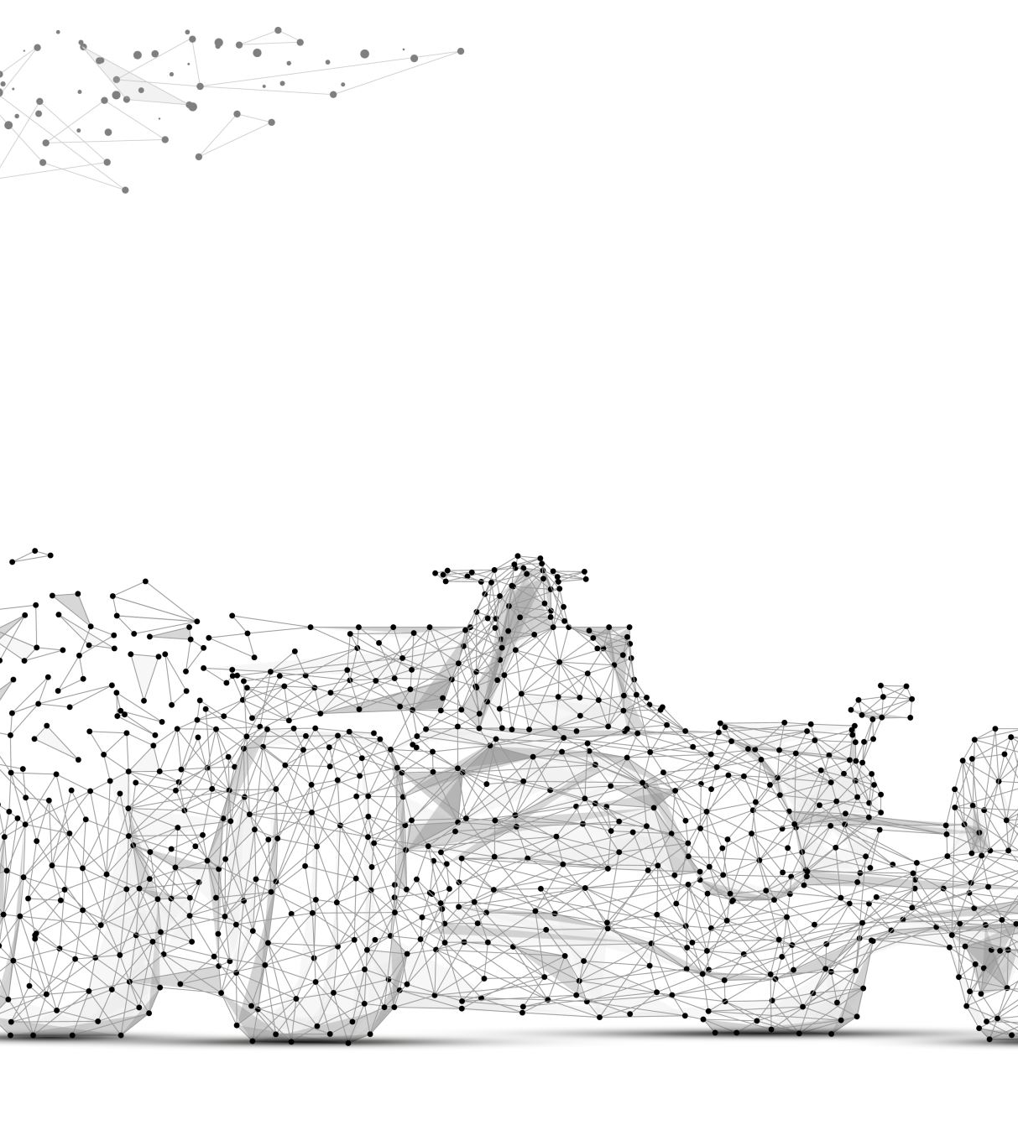
Background
Increasing Demand for Used Cars:
Rising prices of new vehicles drive consumers to the used car market.
Challenges in Manual Price Estimation
Factors like mileage, age, condition, and brand impact the car’s market value.
Machine Learning as a Solution
Machine learning models can automate and improve the accuracy of price predictions.

Slide 7
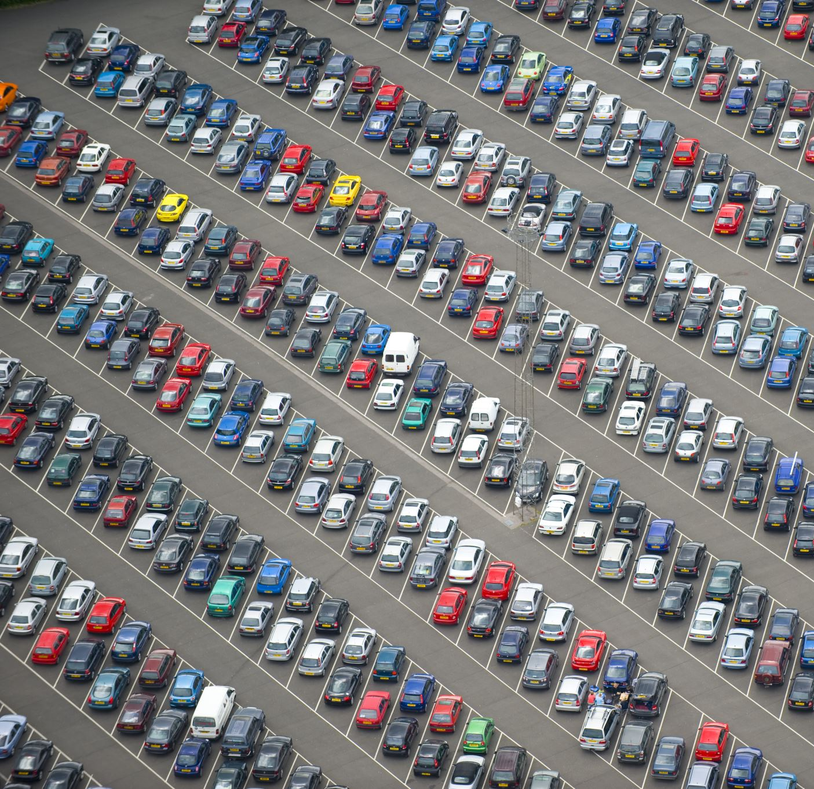
Objective
Automate Car Price Estimation:.
Enable Car Identification Through Image Recognition
Deliverables
Personalized Price Prediction Reports
Car Identification from Uploaded Images
Regular Updates Reflecting Market Trends

Slide 8
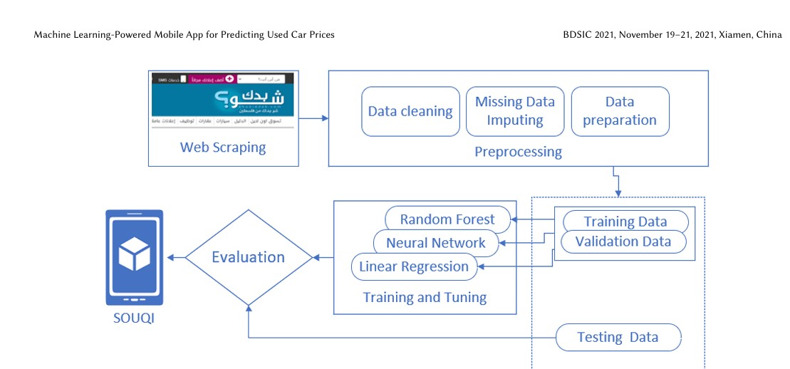
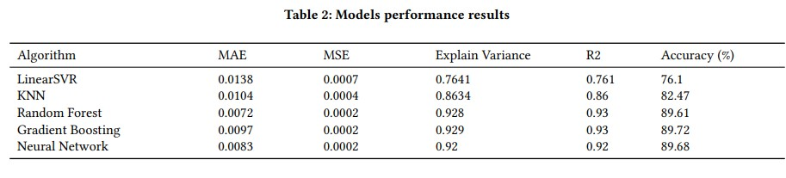
Predictive Analysis of Used Car Prices in Palestine
Main Object:
The research focuses on developing a machine learning-powered mobile app for predicting the prices of used cars.
Dataset:
The dataset includes over 200,000 used car records collected from a popular Palestinian website for used car advertisements.
https://github.com/akramAssi/graduation_projects

Slide 9
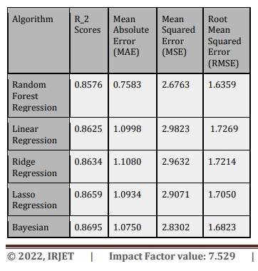
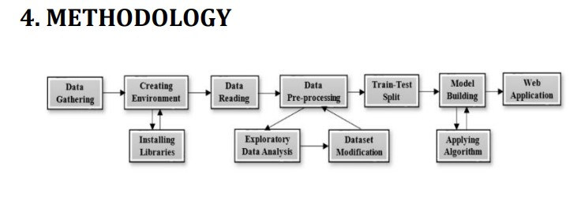
Prediction of Used Car Prices Using Machine Learning
Main Object:
The research focuses on predicting used car prices using machine learning techniques. The goal is to build models that accurately estimate car prices based on various features such as age, kilometers driven, and fuel type.
The dataset was sourced from Kaggle, containing features such as:
Car name
Year of manufacture
Selling price
Current price
Kilometers driven
Fuel type (diesel, petrol, or CNG)
Seller type (dealer or individual)
Transmission type (automatic or manual)
Number of previous owners

Slide 10
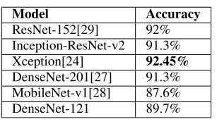
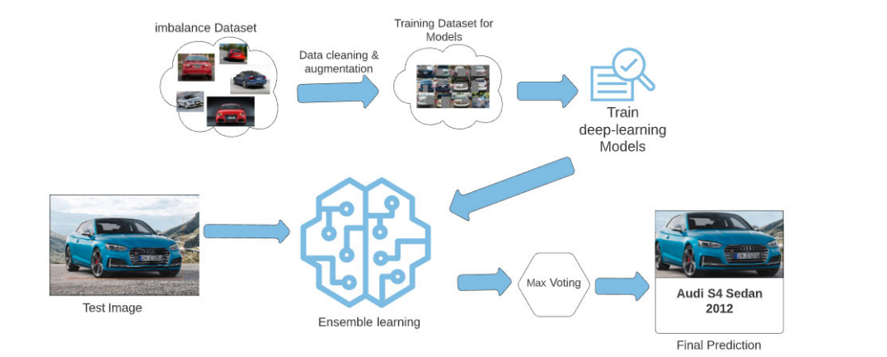
An Empirical Analysis of Deep Learning Architectures for Vehicle Make and Model Recognition
Main Objective
The study will compare and improve the recognition of vehicle make and model using state-of-the-art deep learning techniques
Stanford Cars Dataset: It consists of images of cars from 196 classes. For training, the dataset contains approximately 8,144 images, and for testing, it has about 8,041 images.

Slide 11
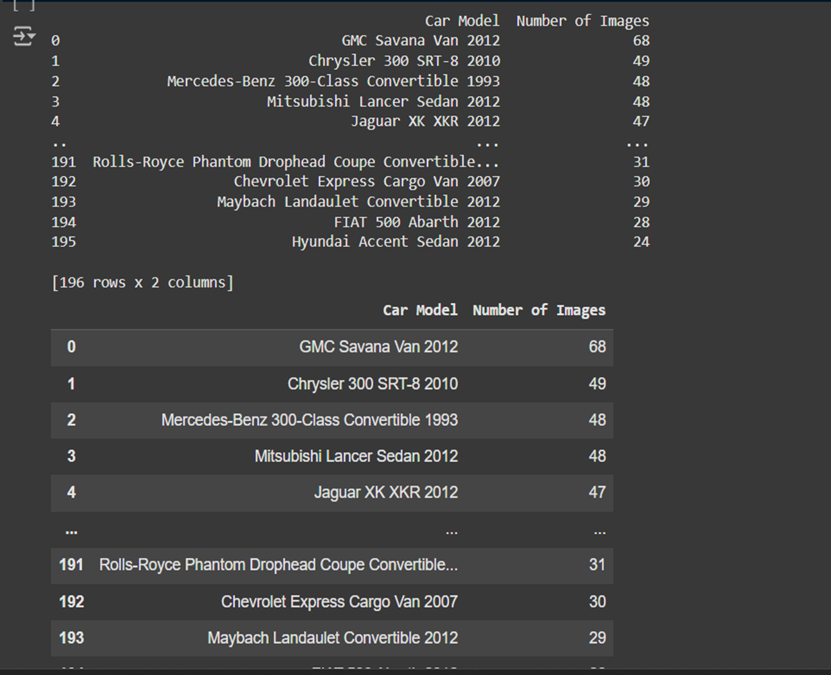
Dataset for detection image
Stanford Cars Dataset: It consists of images of cars from 196 classes. For training, the dataset contains approximately 8,144 images, and for testing, it has about 8,041 images.

Slide 12
Related work
 | Predictive Analysis of Used Car Prices in Palestine | Prediction of Used Car Prices Using Machine Learning
Random forest | 89% | 85%
Gradient Boosting | 89.72 % | 93%
design | Paper 1 (IRJET):web-based machine learning model | mobile application
algorithms | Focuses on regression algorithms: Linear, Ridge, Lasso Regression Random Forest, Decision Tree, XGBoost, Gradient Boosting Decision Tree Regression achieved the best performance with an R² score of 0.9544. | Explores a wider range of algorithms: Random Forest, Gradient Boosting, ANN, Support Vector Regression (SVR), K-Nearest Neighbors (KNN). Random Forest was selected for the mobile app due to its superior performance with 89.61% accuracy.

Slide 13
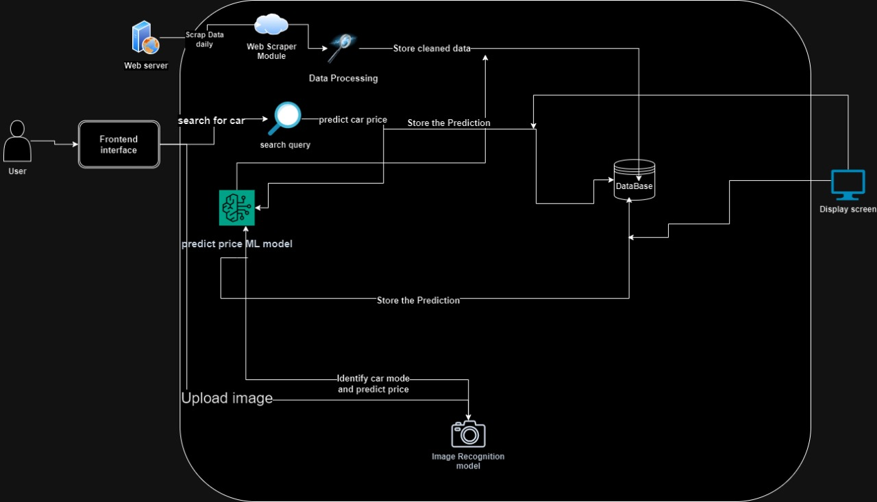
System architecture

Slide 14
Proposed Solution
use web scrapping for get information from website predict prices
Use random forest regression algorithms for predict prices
Image detection use densenet 201 algorithms

Slide 15
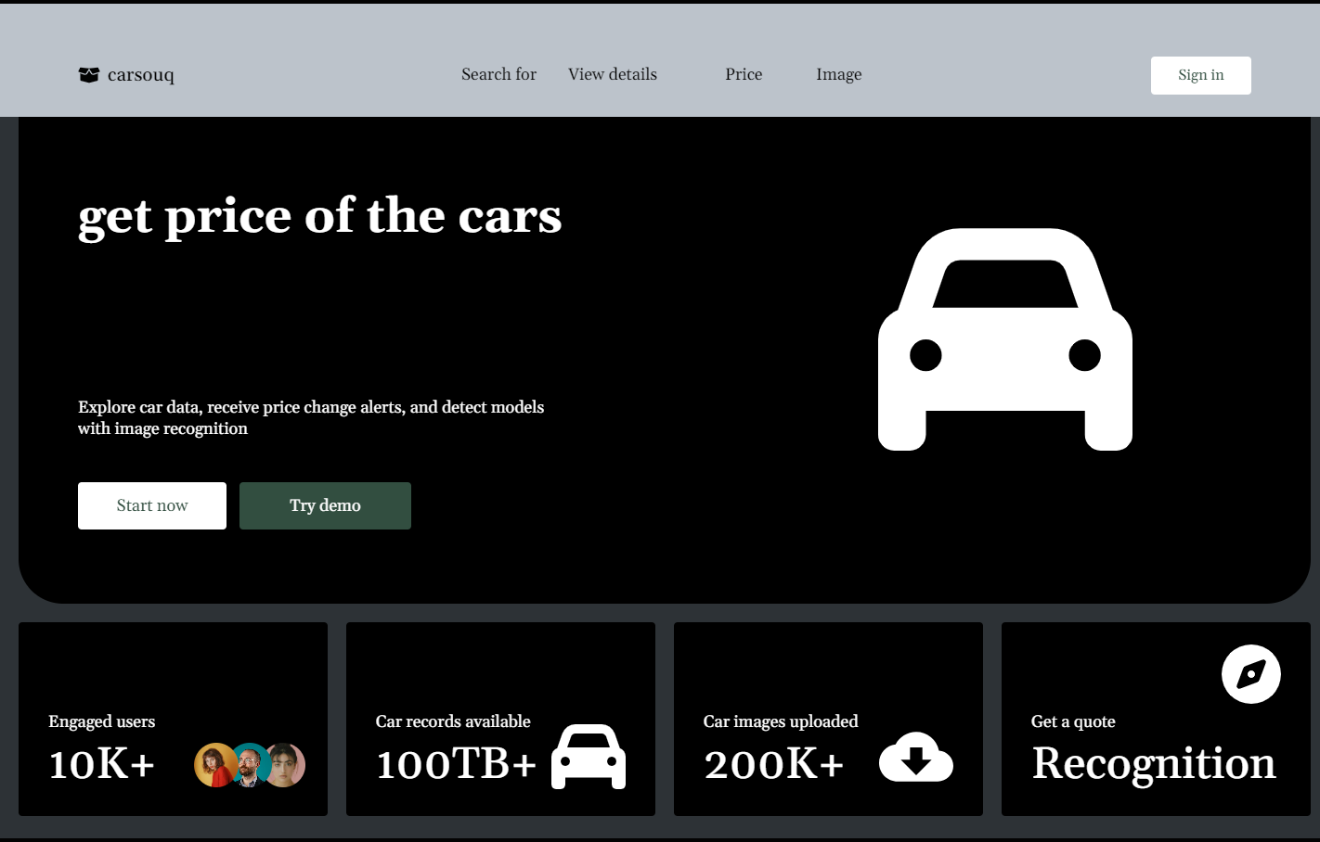
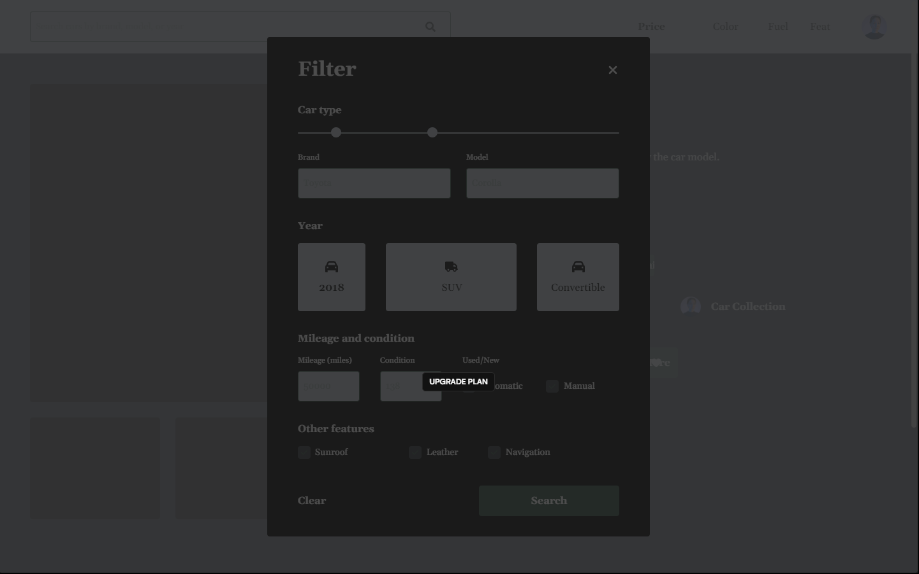
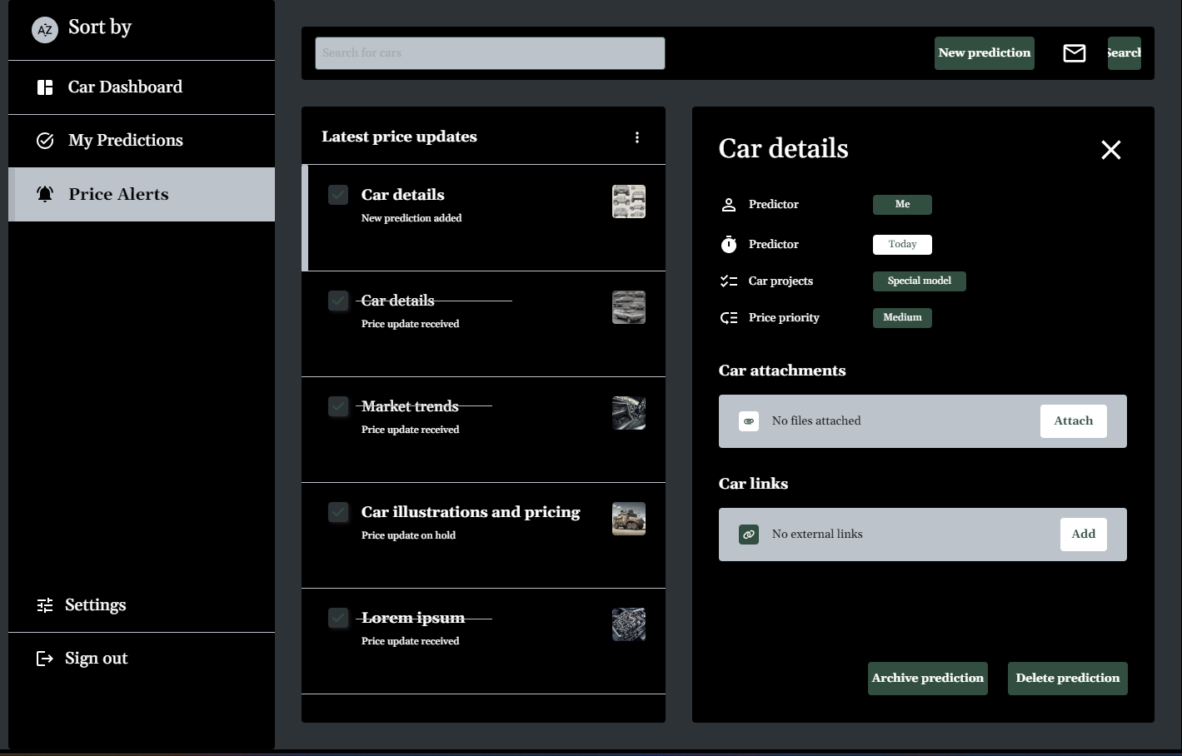
Protype

Slide 16
Conclusion
Robust Data: Web scraping provided valuable data for analyzing used car prices.
Effectiveness: Web scraping efforts yielded robust data for analyzing used car prices.
to help people to know real price of there cars make it much easer

Slide 17
References
http://jomardpublishing.com/UploadFiles/Files/journals/JTME/V5N2/NasibogluR.pdf
https://assets-eu.researchsquare.com/files/rs-3693600/v1_covered_88b2d2cd-32c3-430a-8325-72053d75c8d9.pdf?c=1702809458
https://dl.acm.org/doi/10.1145/3502300.3502307
https://www.irjet.net/
A. Hassan, M. Ali, N. M. Durrani and M. A. Tahir, "An Empirical Analysis of Deep Learning Architectures for Vehicle Make and Model Recognition," in IEEE Access, vol. 9, pp. 91487-91499, 2021, doi: 10.1109/ACCESS.2021.3090766.keywords: {Neural networks;Computer architecture;Deep learning;Image recognition;Training;Degradation;Analytical models;Deep neural networks;vehicle make and model recognition;ensemble learning;k-fold cross-validation},

